Slide 1


Special topics
Session 6
Al-Zahra university
Maryam zim
@maryamzim maryamxiim@gmail.com

Slide 2
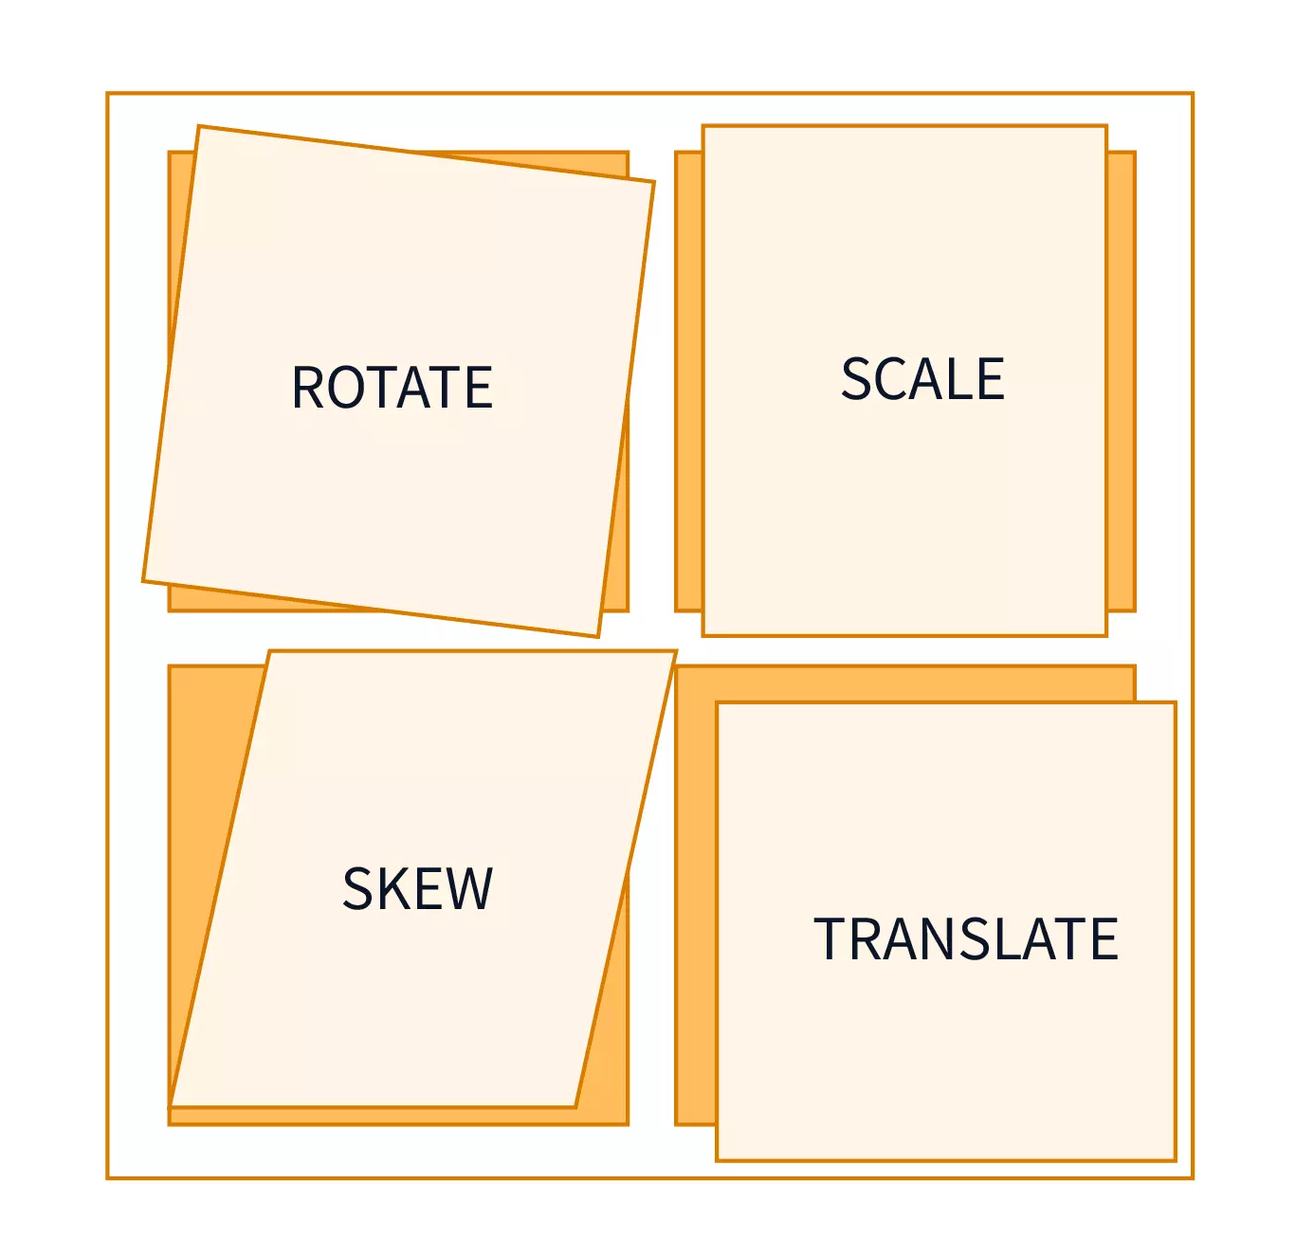
Transform:
The transform CSS property lets you apply two-dimensional (2D) or three-dimensional (3D) transformations to an element. It's used to visually manipulate an element without affecting the layout or position of its surrounding content.
The transform property takes one or more transform functions as its value.

Slide 3
Transform Functions:
The primary use of transform is to apply one of the following geometric operations:
1-translate():
Moves (shifts) the element from its original position without changing its size or rotation.
Function | Description | Example
translate(x, y) | Moves the element horizontally by x and vertically by y. | transform: translate(50px, 10px);
translateX(x) | Moves the element only along the X-axis (horizontally). | transform: translateX(-50%);
translateY(y) | Moves the element only along the Y-axis (vertically). | transform: translateY(20px);
translateZ(z) | Moves the element along the Z-axis (forward or backward in 3D space). | transform: translateZ(100px);

Slide 4
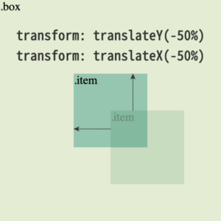
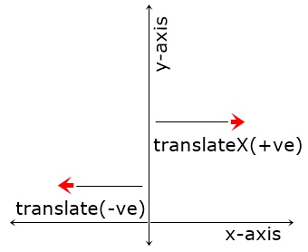

Slide 5
Transform Functions:
2-rotate():
Rotates the element around a fixed point (by default, the center of the element).
Function | Description | Example
rotate(angle) | Rotates the element in 2D space (around the Z-axis). | transform: rotate(45deg);
rotateX(angle) | Rotates the element around the X-axis (tilts it away/toward the viewer). | transform: rotateX(60deg);
rotateY(angle) | Rotates the element around the Y-axis (spins it left/right). | transform: rotateY(180deg);
rotateZ(angle) | Rotates the element around the Z-axis (same as rotate()).

Slide 6
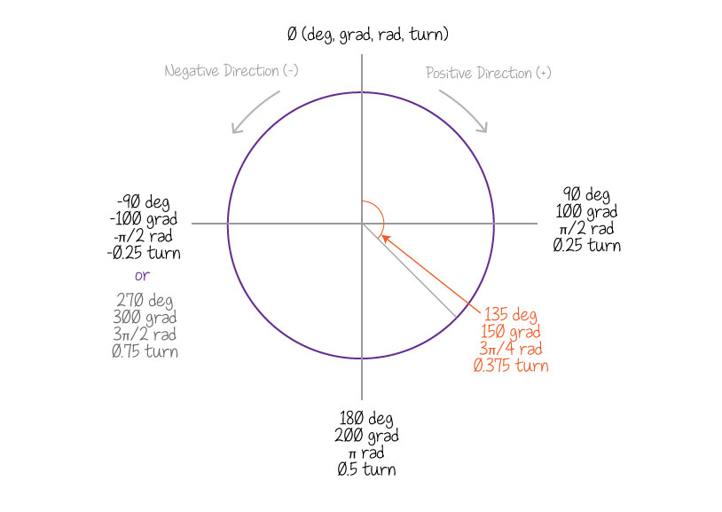
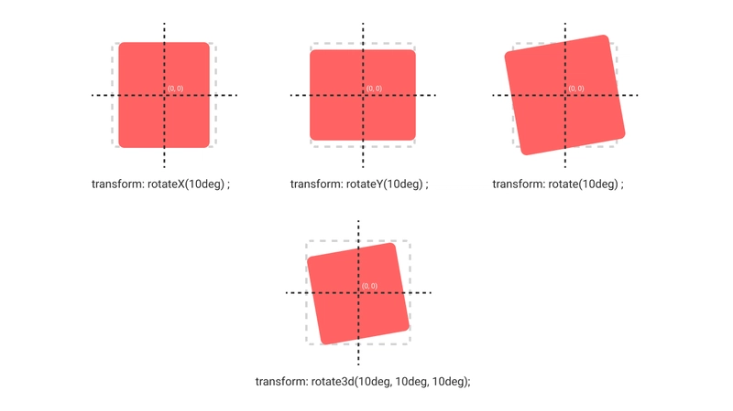

Slide 7
Transform Functions:
1-scale():
Increases or decreases the size of the element.
Function | Description | Example
scale(sx, sy) | Changes the size by the horizontal factor sx and vertical factor sy. | transform: scale(1.5, 0.5);
scaleX(sx) | Scales the element only along the X-axis. | transform: scaleX(2);
scaleY(sy) | Scales the element only along the Y-axis. | transform: scaleY(0.8);

Slide 8
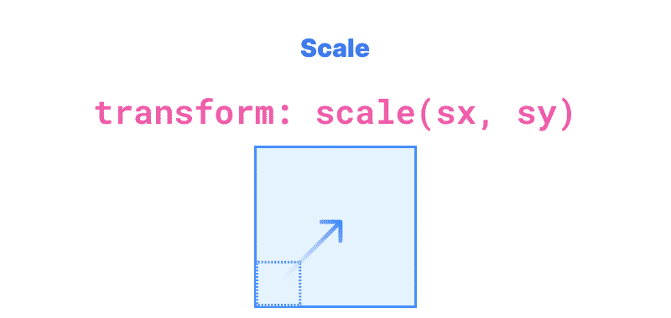

Slide 9
transition:
The transition CSS property provides a way to control animation speed when changing CSS property values. Instead of having a property change instantly from one state to another (e.g., a button instantly changing color on hover), transition allows the change to occur smoothly over a specified duration.
This property is a shorthand for four separate transition properties, making it easy to define a smooth effect in one line of code.
Example Syntax
To transition the background-color and transform properties over half a second with a smooth speed curve:
CSS
.button {
background-color: blue;
transition: background-color 0.5s ease-in-out, transform 0.3s ease;
}
.button:hover { background-color: red; transform: scale(1.1); }

Slide 10
Properties of transition:
Property | Description | Example Value
transition-property | Specifies which CSS property to apply the transition to (e.g., background-color, opacity, transform). | opacity
transition-duration | Specifies how long the transition should take to complete. This is the only required component. | 0.5s (0.5 seconds)
transition-timing-function | Specifies the speed curve of the transition, defining how the speed changes over the duration (e.g., starting slowly, ending fast). | ease-in-out
transition-delay | Specifies a delay before the transition actually starts. | 0.2s

Slide 11
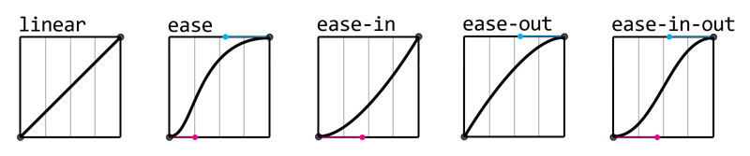
transition-timing-function values:
transition-property values:
all (default): Applies the transition to every animatable CSS property that changes.
Specific Property Name(s): Apply the transition only to the listed properties, separated by commas (e.g., width, opacity).

Slide 12
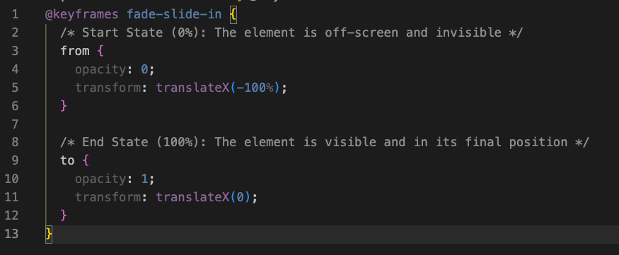
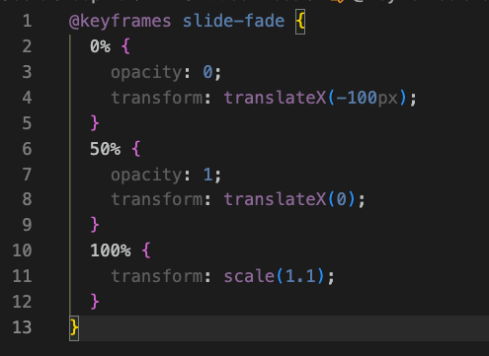
animation:
In CSS, animation is a module that allows you to gradually change an element's style over a specified duration. Unlike transition, which only animates changes between two states (e.g., hover on and hover off), CSS animations allow you to define multiple intermediate states (keyframes) to create complex, continuous, and repeatable effects without needing JavaScript.
How CSS Animations Work
Creating a CSS animation requires two main steps:
1. Defining the Animation States (@keyframes)
The @keyframes at-rule defines the various stages and style changes of the animation.² You specify the styles the element should have at specific points during the animation cycle using percentages or the keywords from and to.
from and to: These are equivalent to $0\%$ and $100\%$, defining the start and end states of the animation.
Percentages: You can define styles at any point between $0\%$ and $100\%$ of the animation duration.

Slide 13
Animation Property Values :
1. animation-name
This specifies the name of the @keyframes rule that defines the animation's sequence.
2-animation-duration
This defines how long one cycle of the animation should take to complete.
3-animation-timing-function:
This defines the speed curve of the animation, specifying how the animation's speed changes over its duration.
animation-timing-function Value | Description
ease (default) | Starts slow, speeds up, and ends slow.
linear | Moves at a constant speed from start to finish.
ease-in | Starts slow, then speeds up until the end.
ease-out | Starts fast, then slows down until the end.
ease-in-out | Starts and ends slowly, with the fastest speed in the middle.

Slide 14
Animation Property Values :
4. animation-delay
This defines the amount of time to wait before the animation starts.
5-animation-iteration-count
This defines how many times the animation cycle should repeat.
animation-iteration-count Value | Description
1 (default) | The animation plays once and stops.
<number> | A positive integer or decimal specifying the exact number of times to run (e.g., 2, 3.5).
infinite | The animation repeats indefinitely (loops forever).

Slide 15
Animation Property Values :
6. animation-direction:
This defines whether the animation should play forward, backward, or alternate between the two.
7. animation-fill-mode:
This specifies what styles are applied to the element before the animation starts and after it ends.
animation-fill-mode Value | Description
none (default) | The element reverts to its original style once the animation is complete.
forwards | The element retains the computed values set in the last keyframe (100% or from/to) based on the animation-direction.
backwards | The element applies the styles of the first keyframe (0% or from) immediately when the page loads, using the animation-delay if present.
both | The animation applies both forwards and backwards behavior.
animation-direction Value | Description
normal (default) | Plays forward each cycle (from 0% to 100%).
reverse | Plays backward each cycle (from 100% to 0%).
alternate | Plays forward on the first cycle, backward on the second, forward on the third, and so on.
alternate-reverse | Plays backward on the first cycle, forward on the second, backward on the third, and so on.

Slide 16
Property | Purpose | Example
animation-name | Specifies the name of the @keyframes rule to use. | slide-fade
animation-duration | Specifies how long one cycle of the animation takes (e.g., 2s). | 2s
animation-timing-function | Defines the speed curve of the animation (e.g., ease, linear). | ease-in
animation-delay | Defines the delay before the animation begins (e.g., 0.5s). | 0.5s
animation-iteration-count | Specifies how many times the animation should repeat (e.g., 2, infinite). | infinite
animation-direction | Defines whether the animation plays forward, backward, or alternates (e.g., normal, reverse, alternate). | alternate
animation-fill-mode | Specifies the styles applied to the element before and after the animation runs (e.g., forwards, backwards). | forwards

